Slide 1

Final Year Design Project CSE 4000B
Team Constant (Group 4)
Supervisor
Mr. Raiyan Rahman
Lecturer, Dept. of CSE
Course Teacher
Dr. A.K.M. Muzahidul Islam
Professor, Dept. of CSE & Director, DCCSA

Slide 2

Meet Our Team
Name
ID
Sama Binte Sharif
011183008
Badruddoza Dhrubo
011201010
Iqbal Ahsan
011201385
Tazveer Hossain Khan
011202132
Tafannum Sanjida Alam Aungona
011202243

Slide 3
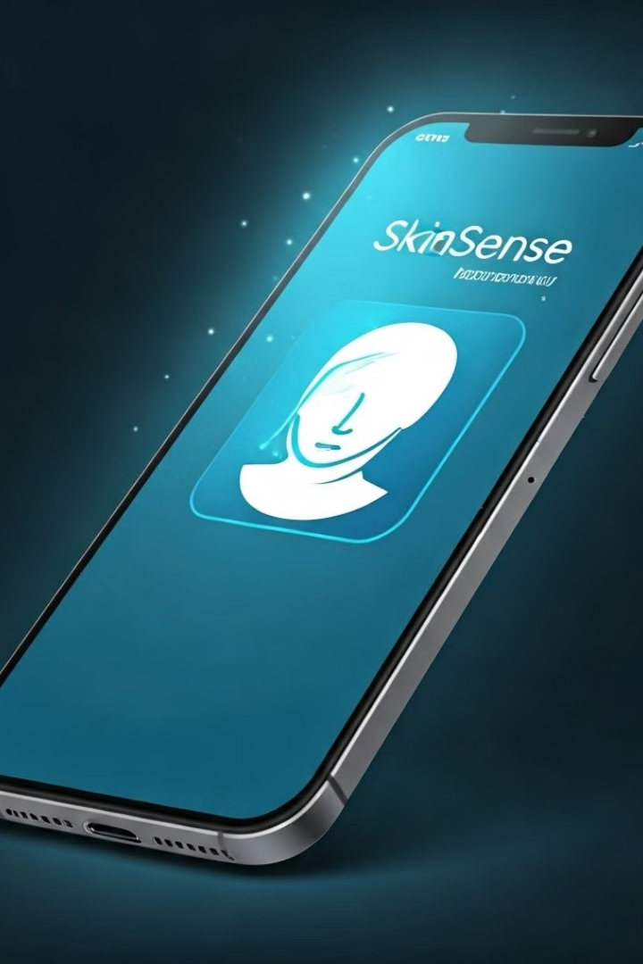
SkinSense: Melasma Disease Detection and Advisory System using Image Processing, Machine Learning & HCI

Slide 4
Table of Contents
1
Introduction
2
Problem Statement &
Our Solutions
3
Motivation
4
Objectives
5
Literature Review
6
Methodology
7
Results & Discussions
8
Impacts
9
Conclusion
10
References

Slide 5

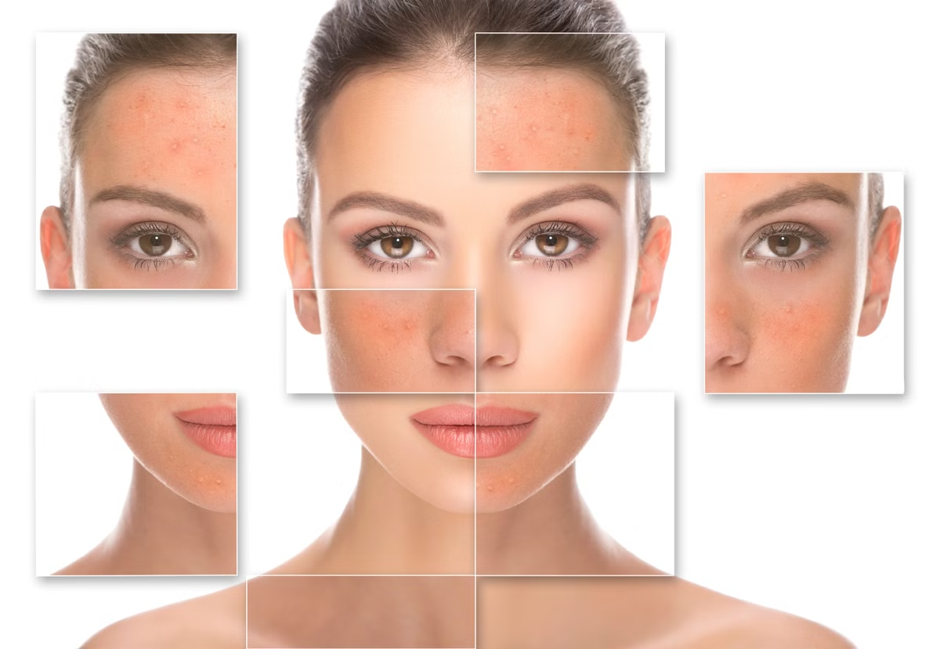
Introduction
What is Melasma?

Slide 6
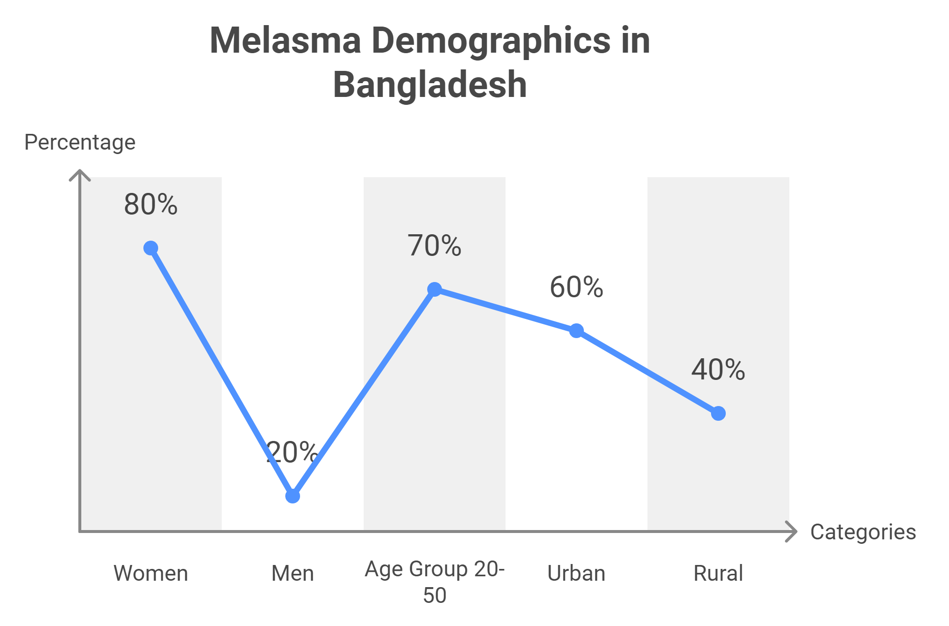
Introduction

Slide 7

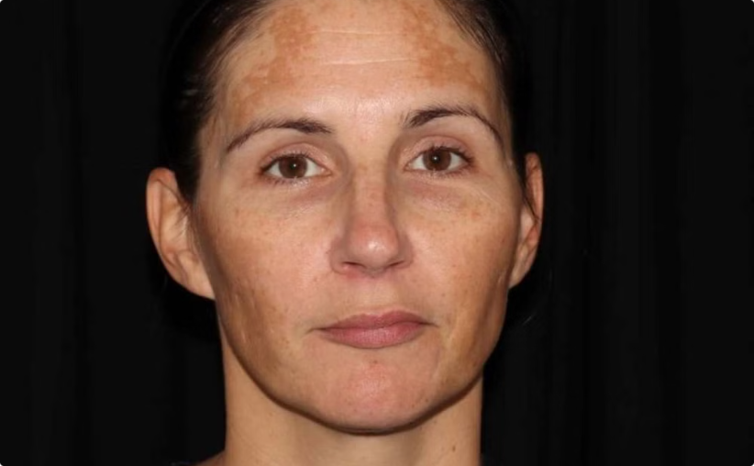
Problem Statement
Limited Access to Dermatologists
The ignorance of Early Melasma

Slide 8
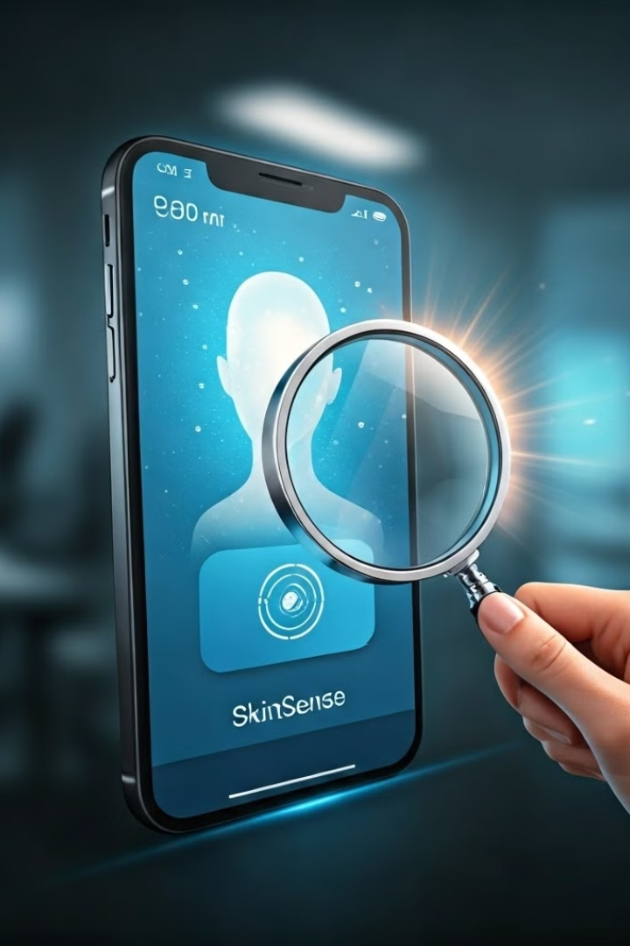
Our Solutions
SkinSense uses image processing and machine learning to quickly analyze skin conditions, providing early Melasma detection and remote medical services.

Slide 9

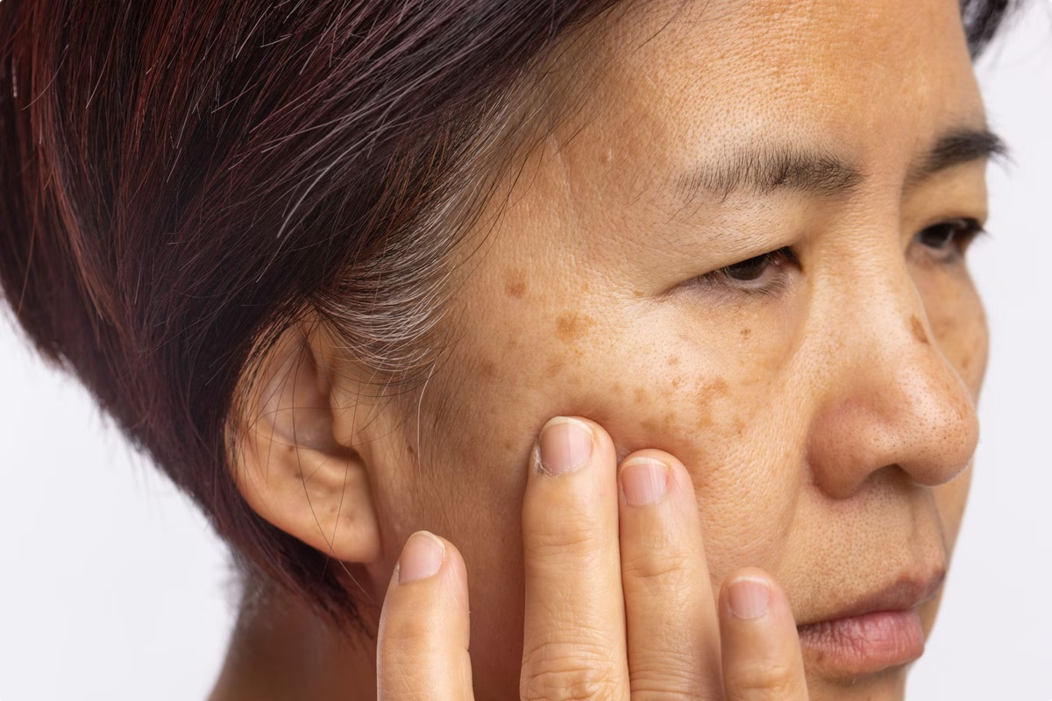
Motivation
The motivation behind SkinSense is to address significant challenges in dermatological care, specifically the early detection and management of Melasma.

Slide 10
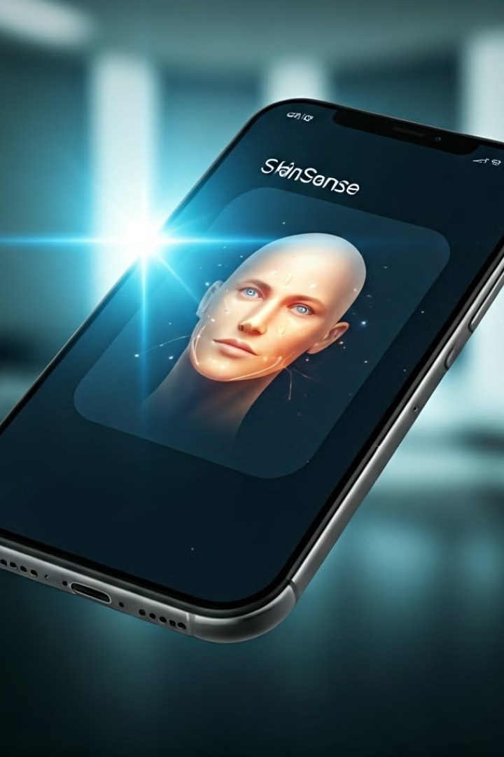
Objectives
1
Develop an accurate diagnostic model
2
Ensure data security and privacy
3
Create a user-friendly mobile app
4
Integrate with healthcare providers
5
Enhance user engagement.

Slide 11
Literature Review
1.
Papers Reviewed: 10
2.
Types of Papers:
Clinical Studies
Deep Learning Models
Technological Advancements
2.1
2.2
2.3

Slide 12
Title
Author
Publication Details
Model
Accuracy
Summary
An Intelligent Diagnostic Model for Melasma Based on Deep Learning and Multimode Image Input
Lin Liu, Chen Liang, Yuzhou Xue, Tingqiao Chen, Yangmei Chen, Yufan Lan, Jiamei Wen, Xinyi Shao, Jin Chen
Dermatology and Therapy, 2022
MobileNetv2
93%
Developed a deep learning model for melasma detection using multimode image input.
Swin Transformer
ResNet50
DenseNet121
Progress and Prospect of Non-Invasive Detection Techniques in the Therapeutic Evaluation of Melasma
Xiao Meng, Chen-Chen Xu
Chinese Medical Journal, 2020
N/A
N/A
Reviewed imaging techniques used to assess melasma severity.

Slide 13
Title
Author
Publication Details
Model
Accuracy
Summary
A Method of Skin Disease Detection Using Image Processing and Machine Learning
Nawal Soliman ALKolifi ALEnezi
Proceedings of the 16th International Learning & Technology Conference, 2019
CNN
100%
Classified three skin diseases (Eczema, Melanoma, Psoriasis)
SVM
The Treatment of Melasma with Fractional Photothermolysis: A Pilot Study
Cameron K. Rokhsar, MD, Richard E. Fitzpatrick, MD
Dermatologic Surgery, 2005
N/A
N/A
Reported melasma clearance in 60% of patients after Fraxel laser treatment.

Slide 14
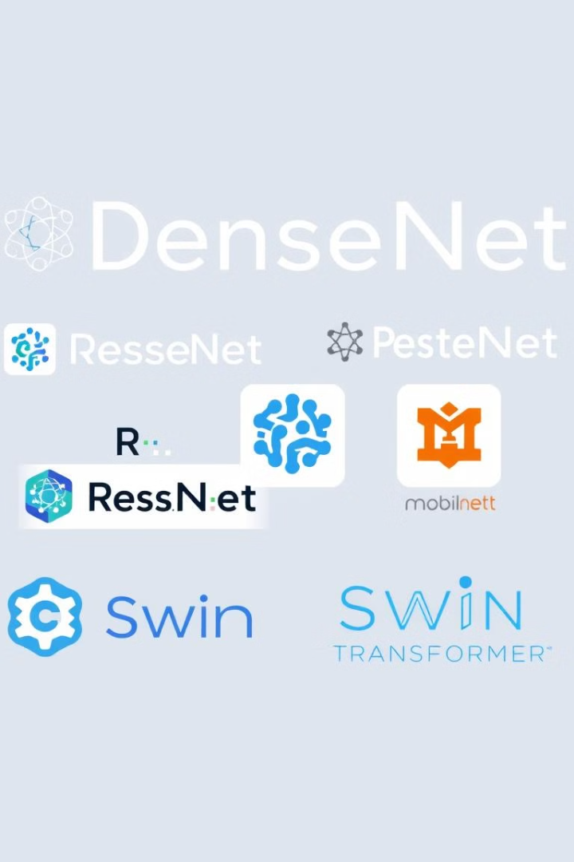
Popular Approaches
1
Convolutional Neural Networks (CNNs)
2
VGG16
3
VGG19
4
Alexnet
5
MobileNetvL
6
ResNet50
7
DenseNet

Slide 15




Methodology
Data Collection
Gather images of skin conditions, focusing on Melasma.
Develop Model
Train a machine learning model to identify Melasma based on the collected data.
Train Data
Fine-tune the model using the collected data to improve its accuracy and performance.
Deploy
Integrate the model into a user-friendly mobile application.

Slide 16





System Diagram
Patients upload their skin disease pictures to our app.
Suggest potential doctor list for online counseling or booking appointment.
The data is recorded and shown
in a mobile app interface.
The data is stored in a cloud database.
The data is fed into our model for detecting diseases by using ML and DIP.

Slide 17
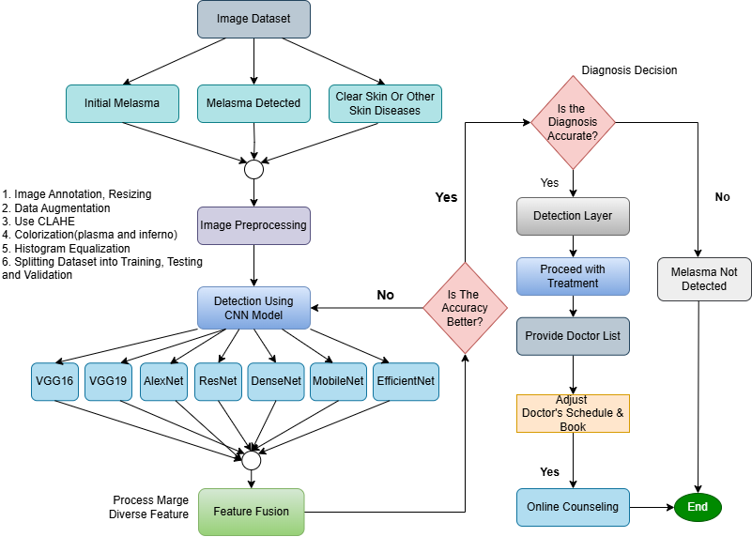
Experimental Design

Slide 18
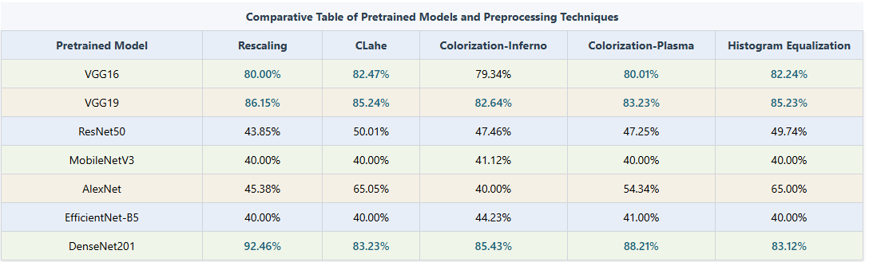
Results & Discussion
58%
100%

Slide 19
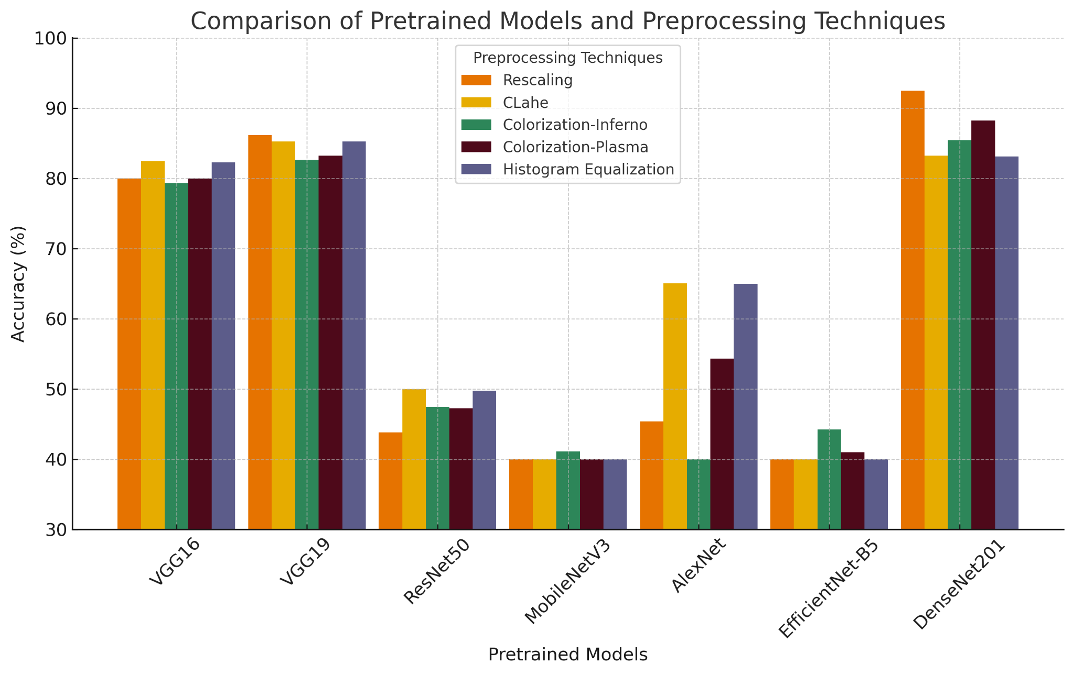

Slide 20
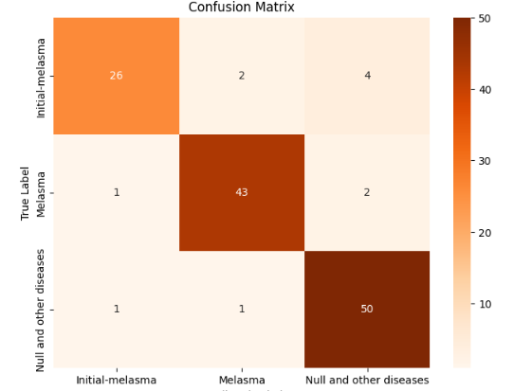

Slide 21
SkinSense: A Positive Impact on Bangladesh
Improved Healthcare Access
1
SkinSense empowers rural communities with accessible dermatological care, reducing the need for long journeys to urban centers.
2
Advancement in Digital Healthcare
SkinSense promotes the adoption of AI and digital health technologies in Bangladesh, paving the way for scalable healthcare solutions.
Data-Driven Healthcare Insights
3
SkinSense leverages anonymized data to gain valuable insights into skin disease prevalence, improving healthcare planning and interventions.
4
Economic Impact
By reducing healthcare costs and boosting the digital health sector, SkinSense contributes to economic growth in Bangladesh.
Improved Patient Outcomes
5
Early detection and reduced diagnostic errors through SkinSense contribute to improved patient outcomes and health management.
6
Social Impact
SkinSense bridges the gap in healthcare access, promotes preventive care, and fosters a more equitable healthcare system in Bangladesh.

Slide 22
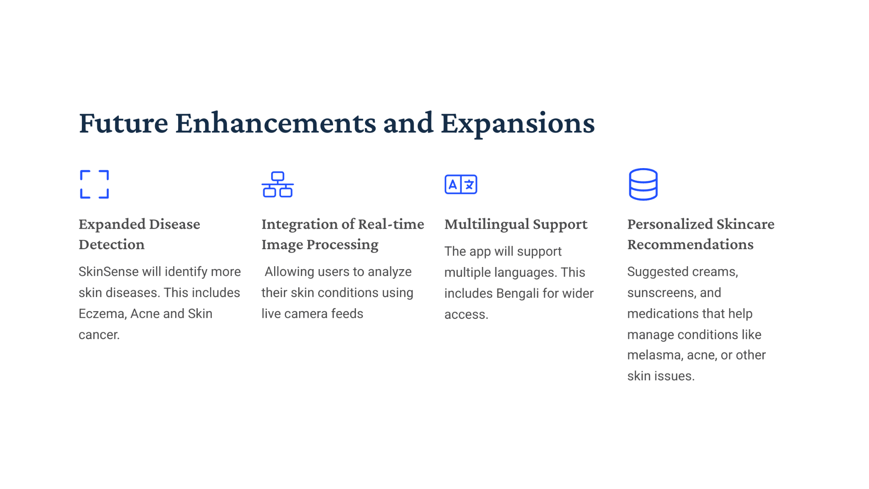

Slide 23

Conclusion
SkinSense represents a significant advancement in addressing the healthcare challenges in Bangladesh. By combining digital image processing, machine learning, and an intuitive user interface, SkinSense empowers individuals to receive accurate, real-time assessments of their skin conditions. The system connects users to local dermatologists, making healthcare more accessible to rural and underserved populations.

Slide 24
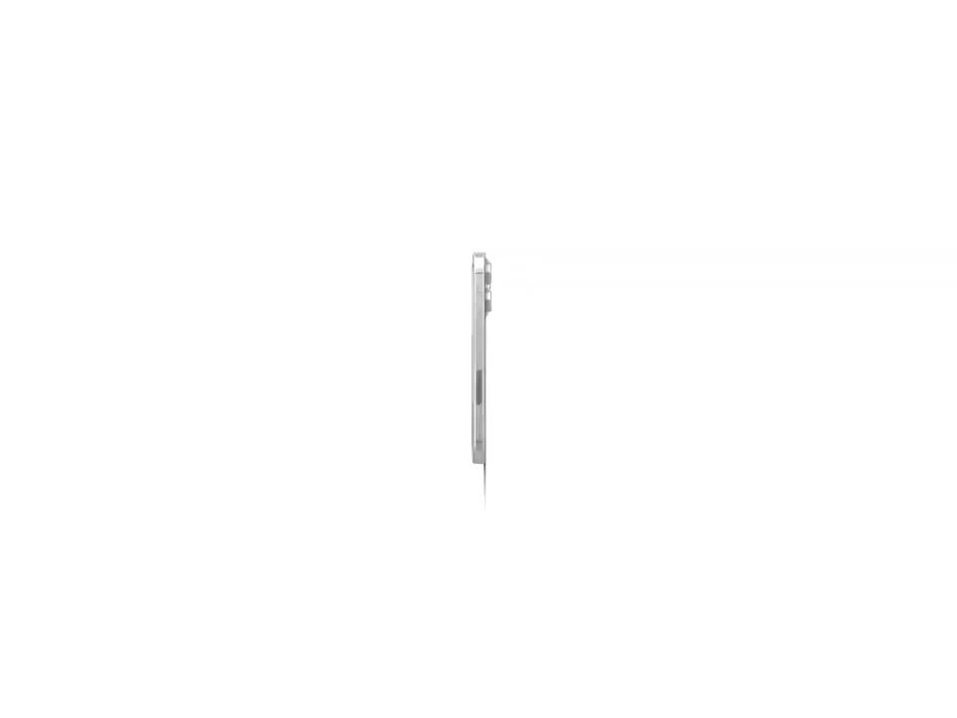
Prototype of SkinSense
Link

Slide 25
References
Rokhsar, C. K., & Fitzpatrick, R. E. (2005). The Treatment of Melasma with Fractional Photothermolysis: A Pilot Study. Dermatologic Surgery, 31(12), 1645-1650. Department of Dermatology and The New York Aesthetic Center, Albert Einstein College of Medicine, Bronx, New York; Dermatology Associates of San Diego County, Encinitas, California​
DOI: 10.2310/6350.2005.31302
2. Liu, L., Liang, C., Xue, Y., Chen, T., Chen, Y., Lan, Y., Wen, J., Shao, X., & Chen, J. (2022). An Intelligent Diagnostic Model for Melasma Based on Deep Learning and Multimode Image Input. Dermatology and Therapy, 12(1), Article 874. https://doi.org/10.1007/s13555-022-00874-z
Meng, X., & Xu, C.-C. (2020). Progress and Prospect of Non-Invasive Detection Techniques in the Therapeutic Evaluation of Melasma. Chinese Medical Journal, 133(17), 2104-2106. Department of Dermatology, Guang’anmen Hospital, China Academy of Chinese Medical Sciences, Beijing 100053, China.
ALEnezi, N. S. A. (2019). A Method Of Skin Disease Detection Using Image Processing And Machine Learning. Proceedings of the 16th International Learning & Technology Conference 2019. Department of Computer Science and Engineering, Umm AL-Qura University, Makkah, Saudi Arabia.

Slide 26

Thank You
Any Questions?
If you have any questions or require further information, please don't hesitate to contact us.

